Slide 1

Pathways
July 2022

Slide 2
Table of Contents
Introduction
PATHWAYS System
Future Work

Slide 3
Introduction
“Pathways will enable a single AI system to generalize across thousands or millions of tasks, to understand different types of data, and to do so with remarkable efficiency – advancing us from the era of single-purpose models that merely recognize patterns to one in which more general-purpose intelligent systems reflect a deeper understanding of our world and can adapt to new needs.” [1]
Today's AI models | Pathways [2]
Typically trained to do only one thing. | Pathways will enable us to train a single model to do thousands or millions of things.
Mostly focus on one sense. | Pathways will enable multiple senses.
Dense¹ and inefficient. | Pathways will make them sparse and efficient.
“…develop the new PATHWAYS system to orchestrate distributed computation for accelerators.” [3]
1. “Dense” means the whole neural network activates to accomplish a task, regardless of whether it’s very simple or really complicated.
[1] https://www.reddit.com/r/MachineLearning/comments/qi0act/d_google_research_introducing_pathways_a/
[2] https://blog.google/technology/ai/introducing-pathways-next-generation-ai-architecture/
[3] https://ai.googleblog.com/2022/04/pathways-language-model-palm-scaling-to.html
Notes:
https://www.reddit.com/r/MachineLearning/comments/qi0act/d_google_research_introducing_pathways_a/

Slide 4
Introduction
Focus on TPU computations.
Adopt a single-controller model.
Use asynchronous distributed (sharded) dataﬂow design.
Apply centralized gang-scheduling heterogeneous parallel computations on distributed accelerators.
Support concurrent execution of MPMD programs with SPMD sub-computations,
Notes:
https://www.reddit.com/r/MachineLearning/comments/qi0act/d_google_research_introducing_pathways_a/

Slide 5
Introduction: GPU vs. TPU[4]
GPU | TPU*
SPMD and MPMD | Single program multiple data (SPMD)
Multithreaded | Single-threaded and only run non-preemptible kernels (centralized gang-scheduling is essential)
GPU kernel running shorter than TPU kernel | TPU kernel can handle far longer-running and more complex computations (written in XLA) without any host interaction, because of using static buffer assignment.
Programmed by dispatching many small pre-compiled “kernels” to the accelerator, and because they are pre-compiled, the kernels must support dynamic shapes. | Because of using static buffer assignment, TPUs have only limited support for dynamic shapes, and adopt the concept of regular compiled functions.
Rich control ﬂow and communication primitives must be executed by driver code on GPU systems. | support rich control ﬂow and communication primitives
Communicate over NVLink or datacenter network (DCN) | Collective communication across the dedicated ICI network
In addition to its specialty in (matrix) computation.
[4] https://dl.acm.org/doi/10.1109/CGO51591.2021.9370308

Slide 6


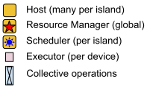
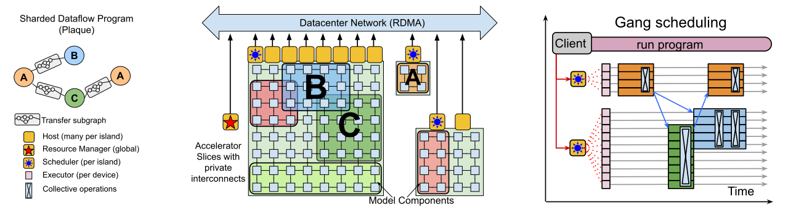
PATHWAYS System
Each node (A, B, and C) represents an individual complied function; edges between nodes represent data ﬂows between functions
Example: distributed computation expressed as a directed acyclic graph (DAG)
Resource Manager
Centralized gang-scheduling

Slide 7
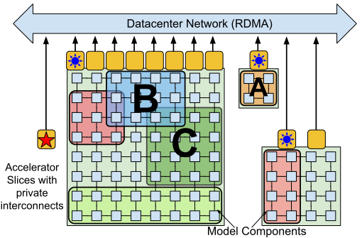

PATHWAYS System: Resource Management
Resource Manager
Resource manager (server side):
Single controller design
Responsible for the centralized management of devices across all of the islands.
Dynamically assign physical devices for virtual devices.
Keeps a one to one mapping between virtual and physical devices.
Statically balance load by spreading computations across all available devices,
Track available devices; add and remove resource dynamically.
Client:
Demand “virtual slices” of the island for computation.
Uses a sharded buffer abstraction to represent a logical buffer that may be distributed over multiple devices for book keeping tasks (such as reference counting)
Islands (consisting of accelerators)
Virtual slice contains virtual devices, assigned by resource manager

Slide 8
PATHWAYS System: Client
Client: run a program
Construct a device location-agnostic PATHWAYS intermediate representation (IR) for the program (expressed as a custom MLIR* dialect)
Call PATHWAYS client library
“Lower” IR progressively via a series of standard compiler passes, output a low-level representation that includes the physical device locations
Convert low-level PATHWAYS IR directly to a PLAQUE program, represent it as a dataﬂow graph.
Assign virtual devices to computations
Register computations with resource manager
Compile computations in background
PATHWAYS
The low-level program takes into account the network connectivity between physical devices and includes operations of output transformation.
*MLIR is a compiler infrastructure designed by Google [5, 6].
[5] https://arxiv.org/abs/2002.11054
[6] https://www.tensorflow.org/mlir

Slide 9
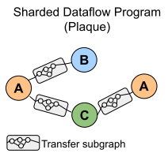
PATHWAYS System: Coordination
PATHWAYS relies on PLAQUE for all cross-host coordination
PLAQUE: an existing (closed-source by Google) sharded dataﬂow system for high-fanout or high-fanin communication.
Representation of PATHWAYS IR must contain a single node for each sharded computation.
Each node generates output data tuples tagged with a destination shard, so when performing data-parallel execution N data tuples would ﬂow, one between each adjacent pair of IR nodes.
Support sparse data exchanges along sharded edges: messages can be sent between a dynamically chosen subset of shards; using standard progress tracking mechanisms to detect when all messages for a shard have been received; avoid the DCN becoming a bottleneck for data-dependent control ﬂow on accelerators (one of the key capabilities of PATHWAYS).
Use coordination substrate: to send DCN messages that are in the critical path for transmitting scheduling messages and data handles; to send critical messages with low latency; to batch messages destined for the same host when high throughput is required.

Slide 10
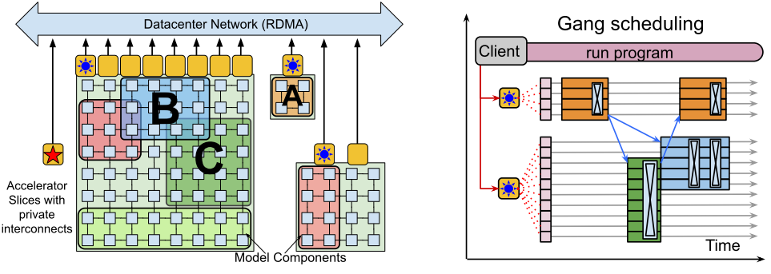
PATHWAYS System: Scheduling
The PATHWAYS runtime includes a centralized gang-scheduler per island that consistently orders all of the computations in the island.
Scheduler (one per island): implement policies for allocating accelerators at a time-scale of milliseconds.
Island (consisting of accelerators)
The PLAQUE dataﬂow program coordinates with the scheduler:
enqueueing the execution of local compiled functions at each accelerator, with buffer futures as inputs;
enqueueing network sends to remote accelerators for the buffer futures output by function executions;
communicating with the scheduler to determine a consistent order of function executions across all programs running on the island.

Slide 11
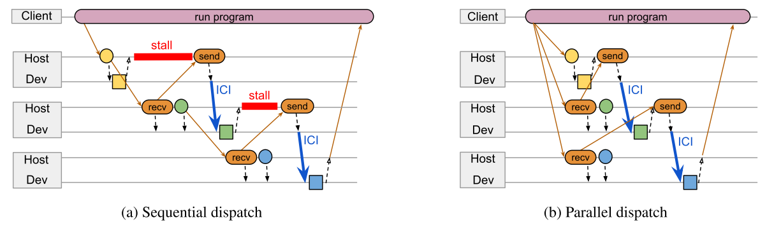
PATHWAYS System: Parallel asynchronous dispatch
Stall: when a computation’s on-device execution time is shorter than the time spent in sequential dispatched host-side work.
Given that the compiled functions are all regular, a successor node’s input shapes can in practice be computed before the predecessor computation was even enqueued.
Parallel asynchronous dispatch exploits the statically known resource usage of regular compiled functions to run most of the host-side work for a computation’s nodes in parallel, and overcomes the issue by running the host-side work in parallel.

Slide 12
PATHWAYS System: Data Management
Each host manages a sharded object store that is similar to Ray’s* object stores, but extended to also track buffers held in accelerator high-bandwidth memory (HBM) at each shard.
Client programs can hold references to objects in remote host or accelerator memory, and the client and servers refer to them using opaque handles that allow the system to migrate them if needed.
Intermediate program values are also kept in the object stores, for example while the system is waiting to transfer them between accelerators, or pass them to a subsequent computation.
The objects are tagged with ownership labels so that they can be garbage collected if a program or client fails.
We can use simple back-pressure to stall a computation if it cannot allocate memory because other computations’ buffers are temporarily occupying HBM.
* Ray: use object stores, but has no HBM (Ray suffer from their lack of a device object store: Ray must transfer the result of a computation from GPU to DRAM before returning the object handle to the client)

Slide 13
Future Work
virtual slice contains virtual devices
Replace PATHWAYS executors and schedulers by long-running Ray actors that would implement PATHWAYS scheduling on top of the underlying Ray cluster scheduling, and executors could use PyTorch for GPU computation and collectives.
Resource Manager
Centralized gang-scheduling
Support features like transparent suspend/resume and migration, where a client’s virtual devices are temporarily reclaimed or reassigned without the need for cooperation from the user program.
Our current implementation simply enqueues work in FIFO order, but more sophisticated schedulers might for example reorder computations based on estimated execution times.

Slide 14
Future Work
Resource Manager* | communication | Data Management | Clients
A more sophisticated allocation algorithm, for example taking into account the resource requirements of all client computations and the current state of the system, to approximate an optimal allocation of physical devices to computations. | Use an extensible, general-purpose, dataﬂow engine to handle DCN communication. The dataflow engine can also be used for background house keeping tasks such as distributing conﬁguration information, monitoring programs, cleaning them up, delivering errors on failures, and so on. | Support data-dependent vectorized control ﬂow. | Handle diverse resource types including but not limited to device and host memory, and ICI, DCN, and PCIe bandwidth; explore common multi-tenancy requirements such as priorities, performance isolation, access control, and resource accounting,
* Current resource manager simply attempts to statically balance load by spreading computations across all available devices.

Slide 15
PATHWAYS vs. Ray
 | Designer | Major Hardware | Resource management | client | Coordination Implementation | Scheduling | Asynchronous | Data management
PATHWAYS | Google | TPU | One resource manager | Developer who uses TPUs mostly in datacenter | PLAQUE, a production sharded dataﬂow system, which can be re-implemented using Ray | Centralized gang scheduler | Yes | “Similar to Ray’s object stores, but extended to track buffers held in accelerator HBM”
Ray | UC Berkeley | GPU | No dedicated resource manager | Developer who use distributed GPUs | Ray’s actors can replace PATHWAYS executors and schedulers. | Application-level scheduling | Yes | Object stores

